Slide 1
Formal Methods for
Software Engineering
Lecture , Part II:
Liveness

Slide 2
Contents
Liveness
  Progress, fairness
Single-lane bridge problem continued
  Congestion
Readers-writers problem
  Locking

Slide 3
Liveness
A safety property asserts that nothing bad happens.
A liveness property asserts that something good eventually happens.
Single Lane Bridge: Does every car eventually get an opportunity to cross the bridge?
A progress property asserts that it is always the case that an action is eventually executed. Progress is the opposite of starvation, the name given to a concurrent programming situation in which an action is never executed.

Slide 4
Fair Choice
  Fair Choice: If a choice over a set of transitions is executed infinitely often, then every transition in the set will be executed infinitely often.
COIN =(toss->heads->COIN
|toss->tails->COIN).
If a coin were tossed an infinite number of times, we would expect that heads would be chosen infinitely often and that tails would be chosen infinitely often.
This requires Fair Choice !
toss
toss
0
1
2
heads
tails

Slide 5

Progress Properties
  progress P = {a₁,a₂,..,a_{n}} defines a progress property P which asserts that in an infinite execution of a target system, at least one of the actions a₁,a₂,..,a_{n} will be executed infinitely often.
COIN system: progress HEADS = {heads}?
progress TAILS = {tails}?
LTSA check progress:
No progress violations detected.

Slide 6

Progress Properties
Suppose that there were two possible coins that could be picked up:
pick
toss
a trick coin and a regular coin……
pick
toss
toss
0
1
2
3
4
5
heads
tails
heads
TWOCOIN = (pick->COIN|pick->TRICK),
TRICK = (toss->heads->TRICK),
COIN = (toss->heads->COIN|toss->tails->COIN).
TWOCOIN: progress HEADS = {heads}?
progress TAILS = {tails}?

Slide 7
Progress Properties
pick
progress HEADS = {heads}
progress TAILS = {tails}
LTSA check progress
toss
pick
toss
toss
0
1
2
3
4
5
heads
tails
heads
Progress violation: TAILS
Path to terminal set of states:
pick
Actions in terminal set:
{toss, heads}
progress HEADSorTails = {heads,tails}?

Slide 8
Progress Analysis
A terminal set of states is one in which every state is reachable from every other state in the set via one or more transitions, and there is no transition from within the set to any state outside the set.
pick
Terminal sets for TWOCOIN:
{1,2} and {3,4,5}
toss
pick
toss
toss
0
1
2
3
4
5
heads
tails
heads
Given fair choice, each terminal set represents an execution in which each action used in a transition in the set is executed infinitely often.
Since there is no transition out of a terminal set, any action that is not used in the set cannot occur infinitely often in all executions of the system - and hence represents a potential progress violation!

Slide 9
Progress Analysis
A progress property is violated if analysis finds a terminal set of states in which none of the progress set actions appear.
progress TAILS = {tails} in {1,2}
Default: given fair choice, for every action in the alphabet of the target system, that action will be executed infinitely often. This is equivalent to specifying a separate progress property for every action.
pick
toss
Default analysis for TWOCOIN?
pick
toss
toss
0
1
2
3
4
5
heads
tails
heads

Slide 10
Progress Analysis
Default analysis for TWOCOIN: separate progress property for every action.
Progress violation for actions:
{pick}
Path to terminal set of states:
pick
Actions in terminal set:
{toss, heads, tails}
Progress violation for actions:
{pick, tails}
Path to terminal set of states:
pick
Actions in terminal set:
{toss, heads}
pick
toss
pick
toss
toss
0
1
2
3
4
5
heads
tails
heads
If the default holds, then every other progress property holds i.e. every action is executed infinitely often and system consists of a single terminal set of states.

Slide 11
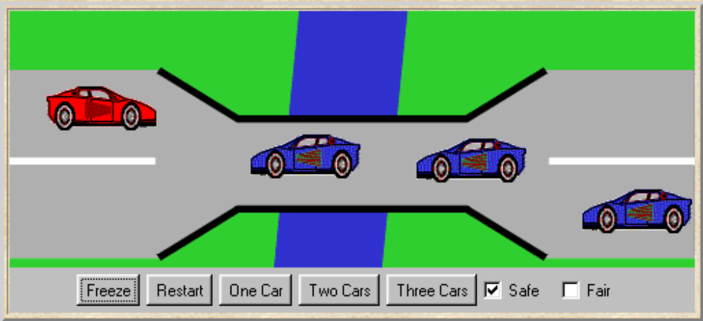
Progress - Single Lane Bridge
The Single Lane Bridge implementation can permit progress violations.
However, if default progress analysis is applied to the model then no violations are detected!
Why not?
progress BLUECROSS = {blue[ID].enter}
progress REDCROSS = {red[ID].enter}
No progress violations detected.
Fair choice means that eventually every possible execution occurs, including those in which cars do not starve. To detect progress problems we must superimpose some scheduling policy for actions, which models the situation in which the bridge is congested.

Slide 12
Progress - Action Priority
Action priority expressions describe scheduling properties:
||C = (P||Q)<<{a1,…,an} specifies a composition in which the actions a1,..,an have higher priority than any other action in the alphabet of P||Q including the silent action tau. In any choice in this system which has one or more of the actions a1,..,an labeling a transition, the transitions labeled with lower priority actions are discarded.
High Priority <<
||C = (P||Q)>>{a1,…,an} specifies a composition in which the actions a1,..,an have lower priority than any other action in the alphabet of P||Q including the silent action tau. In any choice in this system which has one or more transitions not labeled by a1,..,an, the transitions labeled by a1,..,an are discarded.
Low Priority >>

Slide 13
Progress - Action Priority
sleep
NORMAL =(work->play->NORMAL
|sleep->play->NORMAL).
work
0
1
2
Action priority simplifies the resulting LTS by discarding lower priority actions from choices.
play
play
work
||HIGH =(NORMAL)<<{work}.
0
1
play
sleep
||LOW =(NORMAL)>>{work}.
0
1
play

Slide 14
Congested Single Lane Bridge
progress BLUECROSS = {blue[ID].enter}
progress REDCROSS = {red[ID].enter}
BLUECROSS - eventually one of the blue cars will be able to enter
REDCROSS - eventually one of the red cars will be able to enter
  Congestion using action priority?
  Could give red cars priority over blue (or vice versa) ?
  In practice neither has priority over the other.
  Instead we merely encourage congestion by
  lowering the priority of the exit actions of
  both cars from the bridge.
Progress Analysis ?
LTS?
||CongestedBridge = (SingleLaneBridge)
>>{red[ID].exit,blue[ID].exit}.

Slide 15
Progress Analysis
Progress violation: BLUECROSS
Path to terminal set of states:
red.1.enter
red.2.enter
Actions in terminal set:
{red.1.enter, red.1.exit, red.2.enter, red.2.exit, red.3.enter, red.3.exit}
Progress violation: REDCROSS
Path to terminal set of states:
blue.1.enter
blue.2.enter
Actions in terminal set:
{blue.1.enter, blue.1.exit, blue.2.enter, blue.2.exit, blue.3.enter, blue.3.exit}
This corresponds with the observation that, with more than one car, it is possible that whichever colour car enters the bridge first will continuously occupy the bridge preventing the other colour from ever crossing.

Slide 16
Progress Analysis
||CongestedBridge =
(SingleLaneBridge)>>{red[ID].exit,blue[ID].exit}.
red.1.enter
blue.1.enter
blue.2.enter
blue.1.exit
blue.1.enter
red.2.enter
red.1.exit
red.1.enter
0
1
2
3
4
5
6
7
8
blue.2.exit
red.2.exit
Will the results be the same if we model congestion by giving car entry to the bridge high priority?
Can congestion occur if there is only one car moving in each direction?

Slide 17
Revised Single Lane Bridge
The bridge needs to know whether or not cars are waiting to cross. To model this cars request entering the bridge.
CAR = (request->enter->exit->CAR).
Modify BRIDGE:
  Red cars are only allowed to enter the bridge if there are no blue cars on the bridge and there are no blue cars waiting to enter the bridge.
  Blue cars are only allowed to enter the bridge if there are no red cars on the bridge and there are no red cars waiting to enter the bridge.

Slide 18
Revised Single Lane Bridge
/* nr– number of red cars on the bridge wr – number of red cars waiting to enter
nb– number of blue cars on the bridge wb – number of blue cars waiting to enter
*/
BRIDGE = BRIDGE[0][0][0][0],
BRIDGE[nr:T][nb:T][wr:T][wb:T] =
(red[ID].request -> BRIDGE[nr][nb][wr+1][wb]
|when (nb==0 && wb==0)
red[ID].enter -> BRIDGE[nr+1][nb][wr-1][wb]
|red[ID].exit -> BRIDGE[nr-1][nb][wr][wb]
|blue[ID].request -> BRIDGE[nr][nb][wr][wb+1]
|when (nr==0 && wr==0)
blue[ID].enter -> BRIDGE[nr][nb+1][wr][wb-1]
|blue[ID].exit -> BRIDGE[nr][nb-1][wr][wb]
).
OK now?

Slide 19
Analysis of Revised Model
    Trace to DEADLOCK:
    red.1.request
    red.2.request
    red.3.request
    blue.1.request
    blue.2.request
    blue.3.request
The trace is the scenario in which there are cars waiting at both ends, and consequently, the bridge does not allow either red or blue cars to enter.
Solution?
Introduce some asymmetry in the problem (cf. Dining philosophers).
This takes the form of a boolean variable (bt) which breaks the deadlock by indicating whether it is the turn of blue cars or red cars to enter the bridge.
Arbitrarily set bt to true initially giving blue initial precedence.

Slide 20
2nd Model Revision
const True = 1
const False = 0
range B = False..True
/* bt - true indicates blue turn, false indicates red turn */
BRIDGE = BRIDGE[0][0][0][0][True],
BRIDGE[nr:T][nb:T][wr:T][wb:T][bt:B] =
(red[ID].request -> BRIDGE[nr][nb][wr+1][wb][bt]
|when (nb==0 && (wb==0||!bt))
red[ID].enter -> BRIDGE[nr+1][nb][wr-1][wb][bt]
|red[ID].exit -> BRIDGE[nr-1][nb][wr][wb][True]
|blue[ID].request -> BRIDGE[nr][nb][wr][wb+1][bt]
|when (nr==0 && (wr==0||bt))
blue[ID].enter -> BRIDGE[nr][nb+1][wr][wb-1][bt]
|blue[ID].exit -> BRIDGE[nr][nb-1][wr][wb][False]
).
Analysis ?

Slide 21
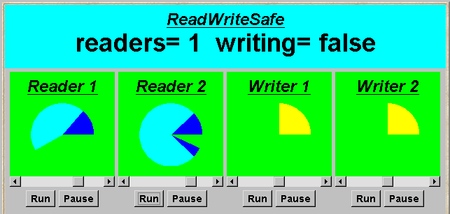
Readers and Writers
Light blue indicates database access.
A shared database is accessed by two kinds of processes. Readers execute transactions that examine the database while Writers both examine and update the database. A Writer must have exclusive access to the database; any number of Readers may concurrently access it.

Slide 22
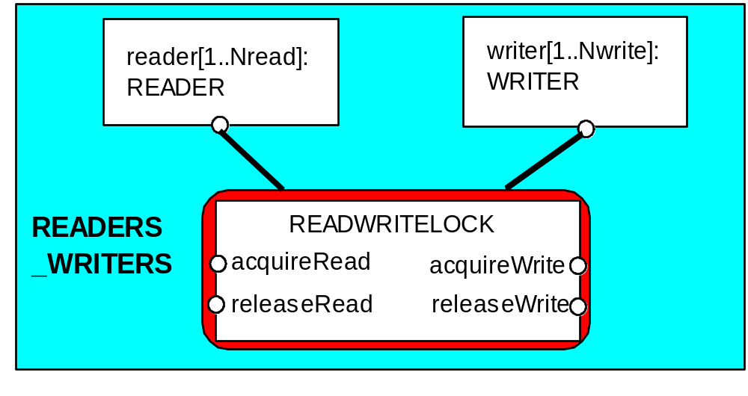
Readers/writers Model
Events or actions of interest?
  acquireRead, releaseRead, acquireWrite, releaseWrite
Identify processes.
  Readers, Writers & the RW_Lock
Identify properties.
RW_Safe
RW_Progress
Define each process
and interactions
(structure).

Slide 23
Readers-writers Model
set Actions =
{acquireRead,releaseRead,acquireWrite,releaseWrite}
READER = (acquireRead->examine->releaseRead->READER)
+ Actions
\ {examine}.
WRITER = (acquireWrite->modify->releaseWrite->WRITER)
+ Actions
\ {modify}.
Alphabet extension is used to ensure that the other access actions cannot occur freely for any prefixed instance of the process (as before).
Action hiding is used as actions examine and modify are not relevant for access synchronisation.

Slide 24
Readers/writers Lock
const False = 0 const True = 1
range Bool = False..True
const Nread = 2 // Maximum readers
const Nwrite= 2 // Maximum writers
RW_LOCK = RW[0][False],
RW[readers:0..Nread][writing:Bool] =
(when (!writing)
acquireRead -> RW[readers+1][writing]
|releaseRead -> RW[readers-1][writing]
|when (readers==0 && !writing)
acquireWrite -> RW[readers][True]
|releaseWrite -> RW[readers][False]
).
The lock maintains a count of the number of readers, and a Boolean for the writers.

Slide 25
Safety Property
property SAFE_RW
= (acquireRead -> READING[1]
|acquireWrite -> WRITING
),
READING[i:1..Nread]
= (acquireRead -> READING[i+1]
|when(i>1) releaseRead -> READING[i-1]
|when(i==1) releaseRead -> SAFE_RW
),
WRITING = (releaseWrite -> SAFE_RW).
Safety Analysis ?
LTS?
We can check that RW_LOCK satisfies the safety property……
||READWRITELOCK = (RW_LOCK || SAFE_RW).

Slide 26
Read-write Lock
acquireRead
An ERROR occurs if a reader or writer is badly behaved (release before acquire or more than two readers).
We can now compose the READWRITELOCK with READER and WRITER processes according to our structure… …
acquireWrite
acquireRead
-1
0
1
2
3
releaseRead
releaseWrite
releaseRead
releaseWrite
releaseRead
releaseRead
releaseWrite
acquireRead
releaseWrite
||READERS_WRITERS
= (reader[1..Nread] :READER
|| writer[1..Nwrite]:WRITER
||{reader[1..Nread],
writer[1..Nwrite]}::READWRITELOCK).
Safety and Progress Analysis ?

Slide 27
Progress Analysis
progress WRITE = {writer[1..Nwrite].acquireWrite}
progress READ = {reader[1..Nread].acquireRead}
WRITE - eventually one of the writers will acquireWrite
READ - eventually one of the readers will acquireRead
  Adverse conditions using action priority?
  we lower the priority of the release actions for both readers and writers.
||RW_PROGRESS = READERS_WRITERS
>>{reader[1..Nread].releaseRead,
writer[1..Nread].releaseWrite}.
Progress Analysis ?
LTS?

Slide 28
Progress Analysis
Writer starvation: The number of readers never drops to zero.
Progress violation: WRITE
Path to terminal set of states:
reader.1.acquireRead
Actions in terminal set:
{reader.1.acquireRead, reader.1.releaseRead,
reader.2.acquireRead, reader.2.releaseRead}
reader.1.acquireRead
Try the Applet!
reader.2.acquireRead
writer.1.acquireWrite
writer.2.acquireWrite
reader.1.acquireRead
reader.2.releaseRead
0
1
2
3
4
5
writer.2.releaseWrite
reader.1.releaseRead
reader.2.acquireRead
writer.1.releaseWrite

Slide 29
Implementation –
Monitor Interface
We concentrate on the monitor implementation:
interface ReadWrite {
public void acquireRead()
throws InterruptedException;
public void releaseRead();
public void acquireWrite()
throws InterruptedException;
public void releaseWrite();
}
We define an interface that identifies the monitor methods that must be implemented, and develop a number of alternative implementations of this interface.
Firstly, the safe READWRITELOCK.

Slide 30
Implementation - ReadWriteSafe
class ReadWriteSafe implements ReadWrite {
private int readers =0;
private boolean writing = false;
public synchronized void acquireRead()
throws InterruptedException {
while (writing) wait();
++readers;
}
public synchronized void releaseRead() {
--readers;
if(readers==0) notify();
}
Unblock a single writer when no more readers.

Slide 31
Implementation - ReadWriteSafe
public synchronized void acquireWrite()
throws InterruptedException {
while (readers>0 || writing) wait();
writing = true;
}
public synchronized void releaseWrite() {
writing = false;
notifyAll();
}
}
Unblock all readers
However, this monitor implementation suffers from the WRITE progress problem: possible writer starvation if the number of readers never drops to zero.
Solution?

Slide 32
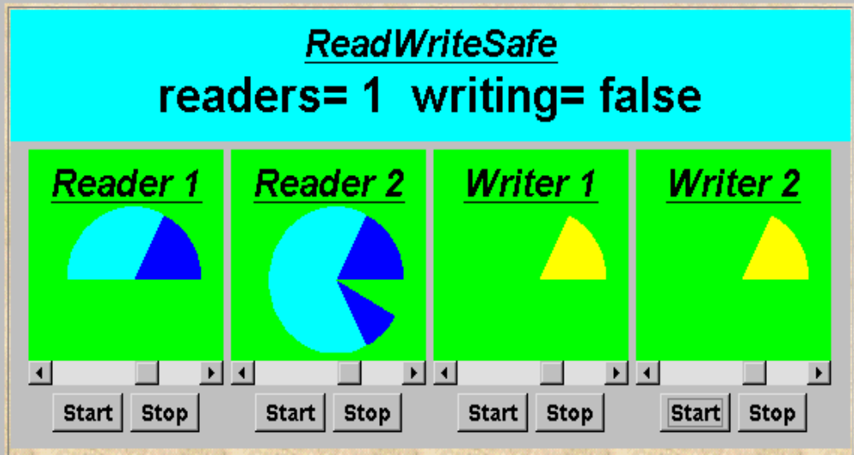
Writer Priority
Strategy: Block readers if there is a writer waiting.
set Actions = {acquireRead,releaseRead,acquireWrite,
releaseWrite,requestWrite}
WRITER =(requestWrite->acquireWrite->modify
->releaseWrite->WRITER
)+Actions\{modify}.

Slide 33
Model - Writer Priority
RW_LOCK = RW[0][False][0],
RW[readers:0..Nread][writing:Bool][waitingW:0..Nwrite] =
(when (!writing && waitingW==0)
acquireRead -> RW[readers+1][writing][waitingW]
|releaseRead -> RW[readers-1][writing][waitingW]
|when (readers==0 && !writing)
acquireWrite-> RW[readers][True][waitingW-1]
|releaseWrite-> RW[readers][False][waitingW]
|requestWrite-> RW[readers][writing][waitingW+1]
).
Safety and Progress Analysis ?

Slide 34
Analysis - Writer Priority
No deadlocks/errors
property RW_SAFE:
progress READ and WRITE:
Reader starvation: if always a writer waiting.
Progress violation: READ
Path to terminal set of states:
writer.1.requestWrite
writer.2.requestWrite
Actions in terminal set:
{writer.1.requestWrite, writer.1.acquireWrite,
writer.1.releaseWrite, writer.2.requestWrite,
writer.2.acquireWrite, writer.2.releaseWrite}
In practice, this may be satisfactory as is usually more read access than write, and readers generally want the most up to date information.

Slide 35
Implementation - ReadWritePriority
class ReadWritePriority implements ReadWrite{
private int readers =0;
private boolean writing = false;
private int waitingW = 0; // no of waiting Writers.
public synchronized void acquireRead()
throws InterruptedException {
while (writing || waitingW>0) wait();
++readers;
}
public synchronized void releaseRead() {
--readers;
if (readers==0) notify();
}

Slide 36
Implementation - ReadWritePriority
synchronized public void acquireWrite() {
++waitingW;
while (readers>0 || writing) try{ wait();}
catch(InterruptedException e){}
--waitingW;
writing = true;
}
synchronized public void releaseWrite() {
writing = false;
notifyAll();
}
}
Both READ and WRITE progress properties can be satisfied by introducing a turn variable .

